Slide 1
Housekeeping
Today:
Imputation review, based on some questions from last time.
Gradient descent in regression.
Batches, stochastic, epochs.
Lots of code.
This stuff is relevant for a bunch of other cases – regularization, neural networks, etc…
Assignment – reminder, please put your github username in the Brightspace asn when done.

Slide 2
Detour - Imputation
Generally, models can’t handle missing data – they’ll fail.
If we have missing data, we need to do something with it:
Delete it.
Impute it – fill in a placeholder value for the missing spot.
Doing either of these is both a simple requirement and potentially complex decision.
We need to do something to make it work, and doing imputation/deletion is simple.
We need some real knowledge, including domain knowledge, to do it well.
We are leaning more towards the former – we need imputation but don’t dig into it.

Slide 3
Impute or Delete
The first decision is to choose to remove data if we have missing values, or impute them.
This is situation dependent – the real-world impact of the values matters.
We can also analyze the data to help make better decisions.

Slide 4
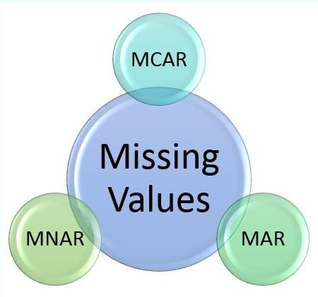
Why is Data missing?
Data can be missing for several reasons.
Missing at Random:
Things missing are partially dependent on other values in the data.
Missing Completely at Random:
This is totally random missing values.
Missing not at Random:
Things missing are depending on their values in the data.

Slide 5
Missing Completely at Random
This is the simplest – an assumption that missing data is randomly distributed.
There is no connection between the values in data and if it is missing.
This is the best candidate for deletion:
The randomness means that losing some data doesn’t impact results.
The only real concern is sample size – in large datasets deletion is easier.
If we shrink a large dataset by 10% (or more) or something, nothing really changes in the model.
If a column is missing a lot of data, we may be better of deleting that column.
This varies depending on the exact data, and what is missing.
Rule of thumb, if it is about 20% or so, start considering – though more missing values than you’d think might be ok in terms of results.

Slide 6
Missing at Random
Missing at random is the default assumption – missing data has some relation with the other values in the data.
“The missingness can be explained by variables on which you have full information”.
Suppose we have census data and the income field is missing from many:
Whether or not the income is missing doesn’t depend on the income value.
Whether or not the income is missing can depend on other values – age, location, etc…
This is a good candidate for imputation:
The imputed value of the mean (or similar) won’t convey a pattern to the data. (no relation.)
The other values, potentially, can help ‘smart’ imputation be accurate.

Slide 7
Missing Not at Random
The worst case – missing values depend on their value.
E.g. high income people may tend to fill out the field on the census, low income don’t.
Overweight people may be less likely to fill out weight in a health survey.
It can also depend on variables outside our dataset or other values as well.
If we just imputed a mean, that would skew the distribution, and that’s bad.
The imputed value has different distributions in the missing vs present sets.
‘Good’ imputation can use more elaborate methods (e.g. estimate proper distribution of the values to be imputed) than we will look at.

Slide 8
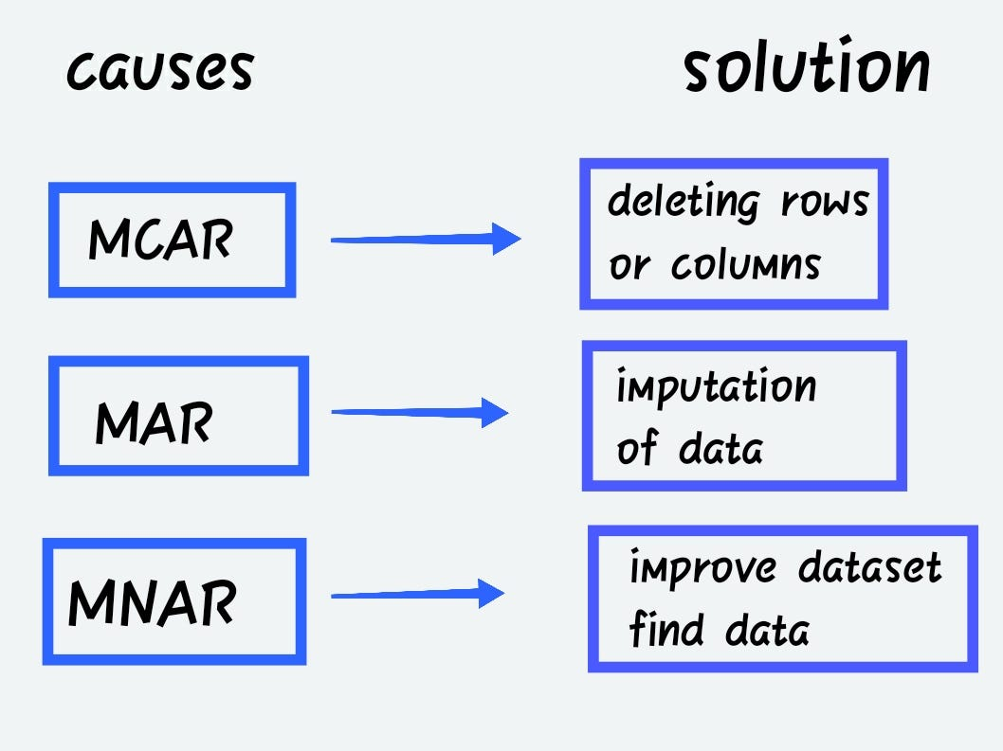
Rules of Thumb
This requires specific knowledge to do ‘right’.
Medicine has lots of analysis on missing data from medical studies.
High consequence, hard to get more data, expensive, low-ish samples to start.
Avoid skewing data for things like life exp.
For us, we need to make reasonable choices.
One generally must happen.
It’s not really a critical thing for us.

Slide 9
Impute This
Imputation is something we need and use all the time, but it is more complex in reality.
Good imputation requires some more elaborate analysis, unless it is simple.
Any solution - imputing or deleting – can introduce bias into the data.
Ideally we want to minimize that bias (i.e. don’t change the data patterns):
If deleting data, we want to ensure that we aren’t deleting data from one part of the dist.
For imputing data, we want to ensure that the data we insert matches the dist.
There is no perfect answer – everything is a patch.
At a high level, the ML models pick up on patterns in data. Imputation generates fake data, but if done well, won’t impact that pattern – so the model learns the same thing.

Slide 10
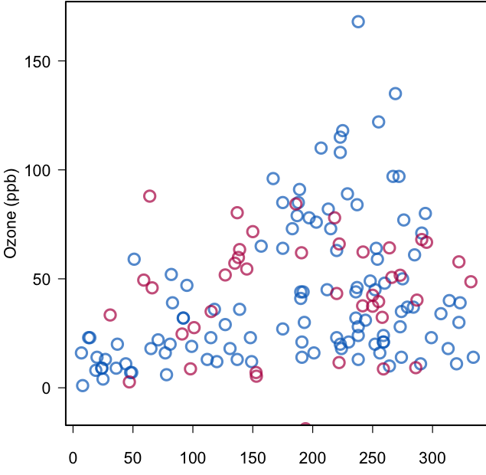
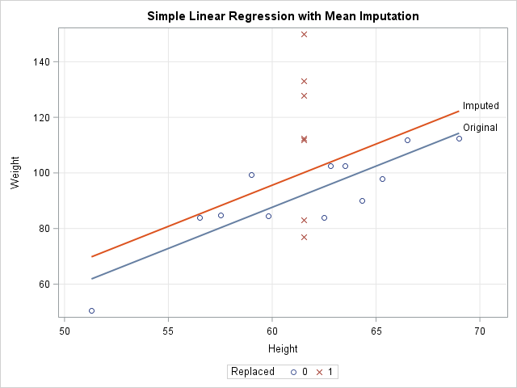
Example – Linear Regression
This has simple mean imputation on height.
Inserting the imputed height introduces some bias.
The average weight of the imputed data is higher than the observed.
Those heavy players are likely taller in reality.
The model shifts due to bias.
The upper picture is better – no change in pattern of the data.

Slide 11
Gradient Descent

Slide 12
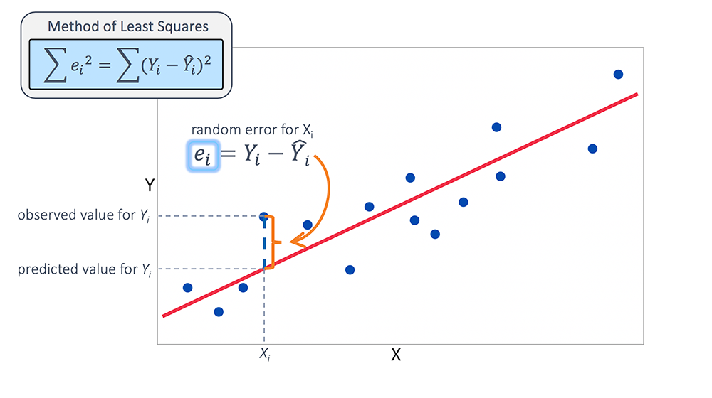
Linear Regression Error
In linear regression we normally take the mean squared error – the linear regression model is calculated by getting the linear least squares.
If we were to move our model around (up/down/angle), we’d get worse errors – the LLS point is optimal.
Think about if we were to plot that amount of error – there’d be a minimum at the current spot, and everywhere else would have slightly more error…

Slide 13
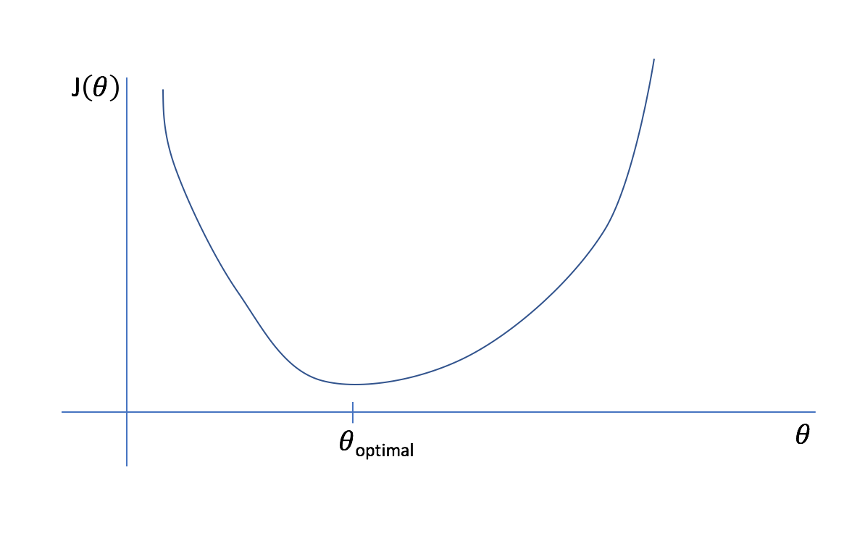







Plot of MSE of Linear Regression vs Coefficient
Other linear models have more error.
Y = m*x + b with different m and b values.
LLS model has the lowest error.

Slide 14

Gradient Descent Basics
Gradient descent is one, common and effective, method of optimizing.
We use it to optimize the cost function (more in a second).
The idea of gradient descent if very simple:
Make a guess.
Calculate the gradient (the slope of the cost curve).
Move to make that cost lower (down the curve)
Repeat until you’re at the bottom.
Each move gives a slightly more accurate model.

Slide 15
Gradient Descent
So, in basic terms, gradient descent:
Calculates the current cost (as measured by some error function).
Does some calculus (partial derivatives) to attribute that error to each term. (m1 * x1)
Uses the calculus to determine if the parameter needs to go up/down (gradient/slope).
Adjusts each parameter in that direction, proportional to the learning rate.
Calculate cost and repeat.
This process is the same no matter what is being descended – regression, classification…
The thing that changes is how the cost (error) is measured.

Slide 16
Cost Function
Gradient descent depends on the idea of a cost function.
A cost function is just a function that calculates “cost” for a model – or error.
The best model has the lowest cost, or the least error.
The cost function is internal to the model – it is just for training.
Does not need to be the ‘accuracy’ we care about – classification uses (usually) cross-entropy for a loss function, but the result we care about is accuracy.
As long as we can express it in a formula, almost anything can be our cost.
For linear regression, it has been MSE. For a class tree, it is gini/entropy.
Cost functions are often called loss functions. Loss is technically for one input, cost is for all. 99.999% of the time they are interchangeable.

Slide 17
Different Costs
A model can use any cost function with gradient descent, as long as it is differentiable(ish).
Most scenarios use one of a few (more in NN):
Regression: mean squared error, mean absolute error.
Classification: cross-entropy, hinge.
In theory, we can make a custom one if scenario demands – it just needs to report error:
Suppose a model predicts needed thickness of a bridge support.
Being slightly too thick is a minor error, being slightly too thin is the Tacoma Narrows.
A price is right regression might penalize being too low only a little, and too high a lot.
A bank may weight different things than raw accuracy in fraud prediction.
A predictive model to drive a car probably has some different metrics for ‘good’.

Slide 18
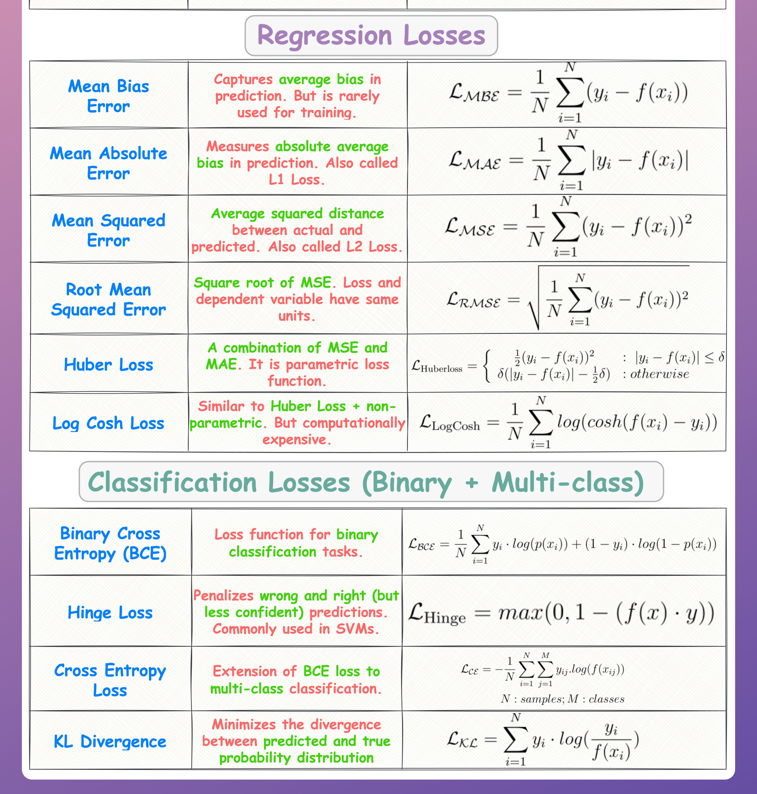

Slide 19
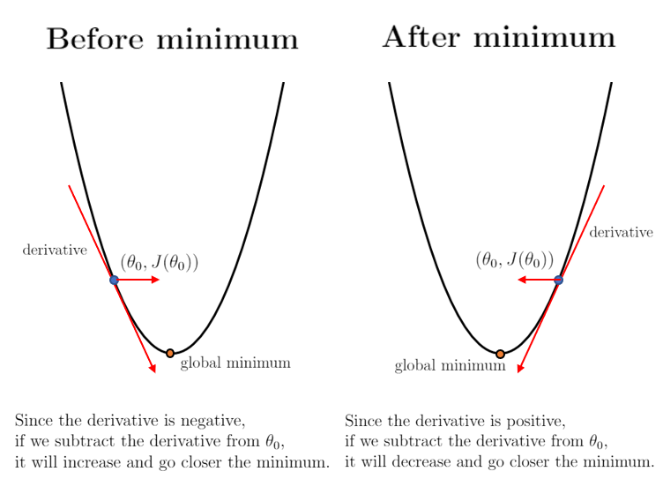
Linear Regression Cost and Descent
For linear regression the cost is normally just MSE.
So doing gradient descent we:
Calculate the cost for where we are.
Calculate the gradient, or the slope of the cost curve.
Move so that we are going down the slope.

Slide 20
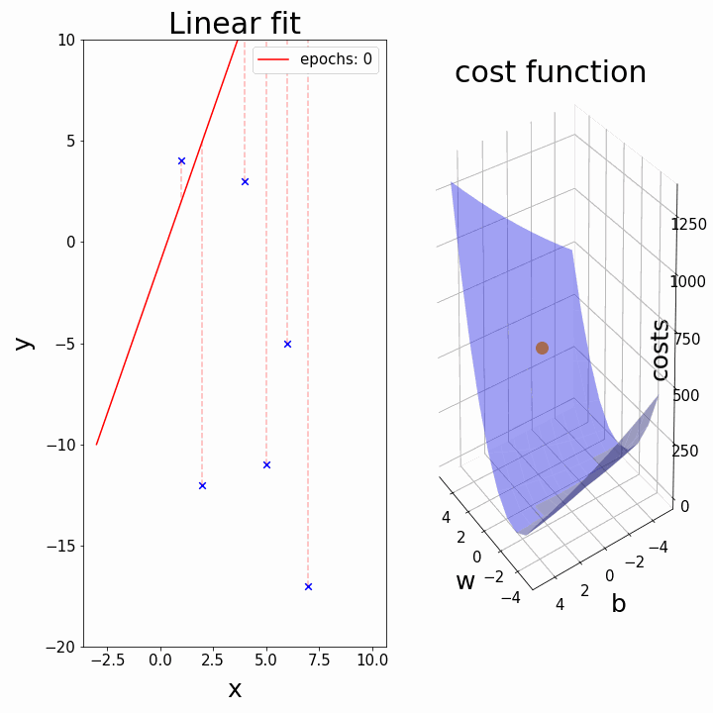

Slide 21
Detour - Convergence
Convergence is the term for when the gradient descent algorithm finds an answer.
We may get warnings if our model doesn’t converge:
Add more iterations.
Change gradient descent settings like learning rate and some others (later in NN).
Add randomness – more later.
Set limits – if the model isn’t improving enough, stop at that point.
Quicker convergence means that the gradient descent process needs fewer rounds.
This doesn’t give us a different/better answer.
With large examples, this can make a real difference and allow more trials.

Slide 22
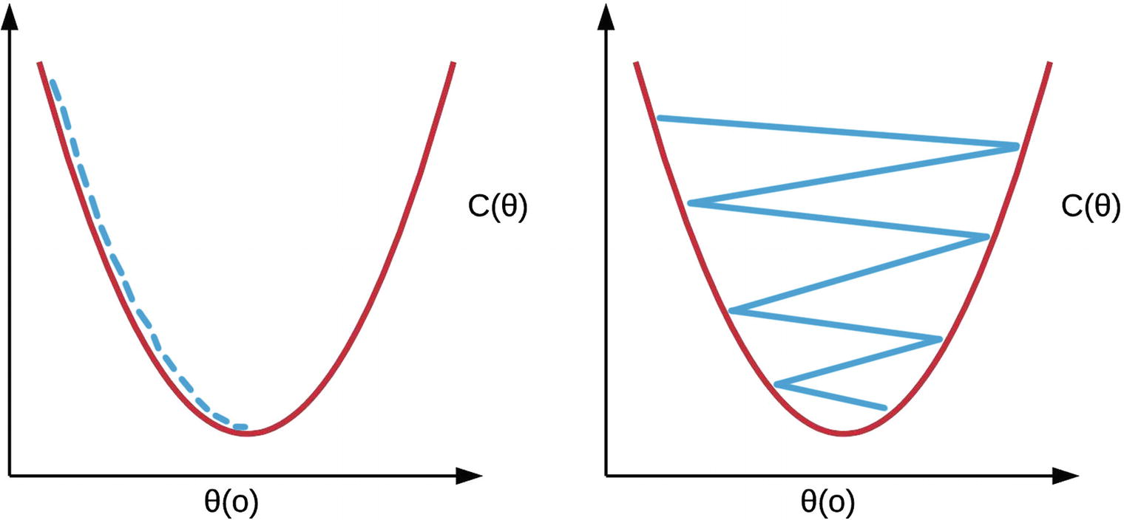
Learning Rate – how much to move
In gradient descent we also have a learning rate.
The LR determines how big the jumps are.
Small LR – slow changes, unlikely to “skip around”.
Large LR – large changes, unlikely to “get stuck”.
In practice (sklearn) start big, and slow down as we converge on an answer.

Slide 23
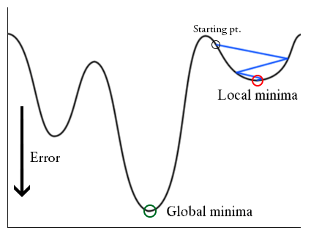
Local Low Points
One thing the learning rate impacts is the way the model handles local minima.
In complex data with thousands of dimensions, this becomes more likely.
Having a learning rate that is too low does not let a model escape a local minima.

Slide 24
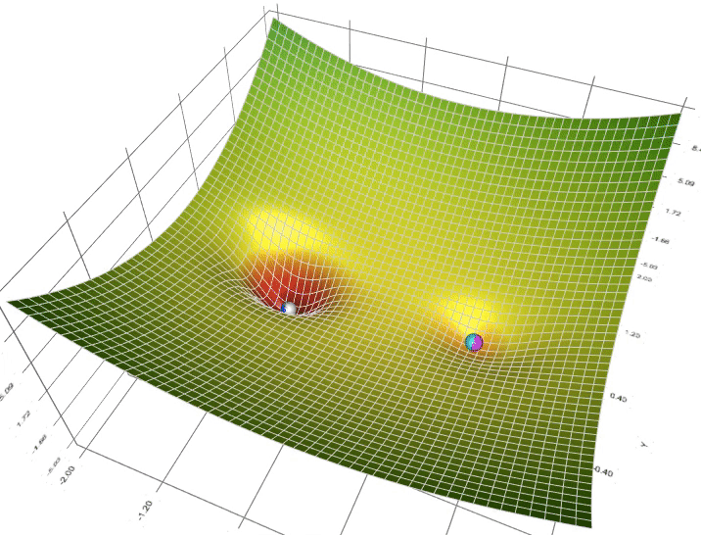

Slide 25
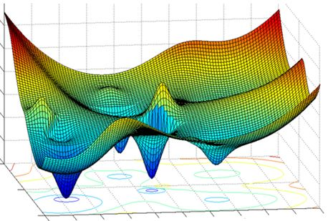
Skip Around?
With more complex data, with many features, the cost isn’t a simple curve – this may be in millions of dimensions.
There may be local minima – places where the cost dips low, but not the lowest points.
The LR needs to be high enough that we don’t get stuck.
Several approaches target this:
Variable rate – move lots when steep, then slow down.
Different optimization strategies (more in NN).
This is a major area of analysis for NN – faster convergence means better models.

Slide 26
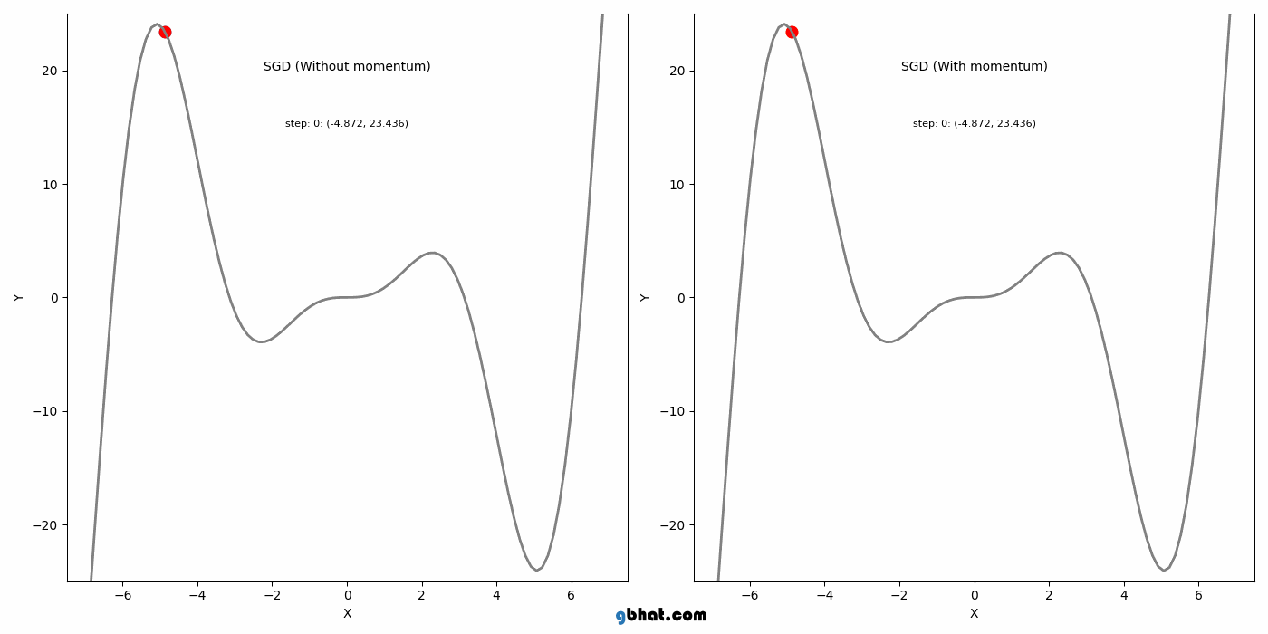
Smarter Descending
In practice, algorithms can use things like momentum to try to optimize jumps.
Momentum is basically a moving average of the gradients.
“Smart” rate to optimize.
Small steps when things oscillate.
Large steps when things are in the same direction.

Slide 27
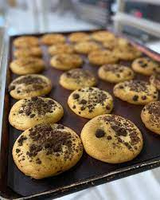
Let’s mix up a batch

Slide 28
Terminology Break
These terms are common and generally how we refer to things in training:
Batch – one training round before parameters are updated.
Epoch – one training round though all of the data.
Parameters – each trainable thing – a slope/intercept here – in a model.
These can be the same, and often are, but with larger data/models, they’re separate.
Up until now batch = epoch.

Slide 29
How many Gradients To descend?
Normal gradient descent updates after all the data is seen – Batch Gradient Descent.
In many cases, we may update the parameters after only having seen some of the data.
This subset is called a batch (of size whatever).
E.g. in large models to do image recognition or generate text, data can’t fit in memory.
In other cases, training may be more efficient with smaller batches.
This has a few impacts:
Training can be faster or memory efficient, since less data is needed.
Results are more random – since we only see a subset of data at a time.
This is most useful in larger data – saving iterations allows more training or trials.

Slide 30







Stochastic Example
Suppose a current param is .5.
If we used the full set, the param is near correct.
If the record selected is red, that will barely influence it.
The ‘correct’ slope for these points is ~.5.
If the record selected is orange:
Update is large, since value if different.
The ‘correct’ slope for these might be 2, or .1 – that’ll change the parameter more.
This is the random variation in action.

Slide 31
Shortcuts and Stochastic GD
There are a few shortcuts that we can take to save time:
Calculating all of those derivatives in a gradient descent can be slow!
Enter Stochastic, or random, Gradient Descent.
Instead of calculating all of the gradients, stochastic just randomly does one.
More ’randomness’ in finding a solution, but faster iterations.
Sklearn’s implementation is Stochastic Gradient Descent (SGD).
There is also mini-batch GD, which randomly chooses a group.
Stochastic can be better when cost curves are not simple curves, as the randomness can avoid minima.

Slide 32
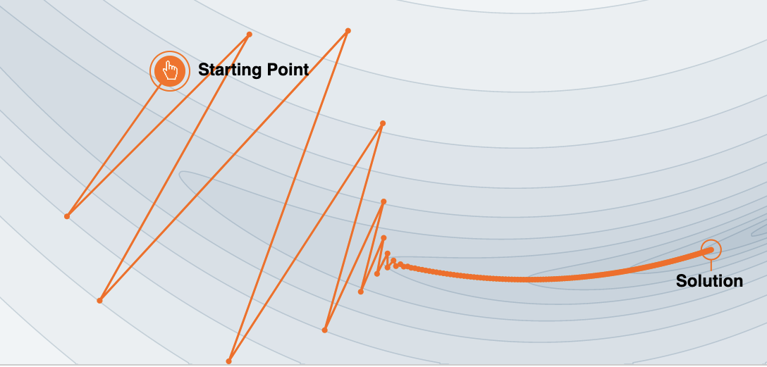
Stochastic Gradient Descent
Stochastic (random) gradient descent updates after every one row of data.
The record to use is random each time, batch size = 1.
This is fast for each batch, since it only uses one row of data per round.
Rapid changes in the parameters.
The record to use is chosen at random.
This is more random – swings in the results are larger the less data is used.
There may be way more batches before convergence.
Less likely to get stuck in a local minima due to randomness.
E.g. we are calculating the change in parameter values based on one record.

Slide 33
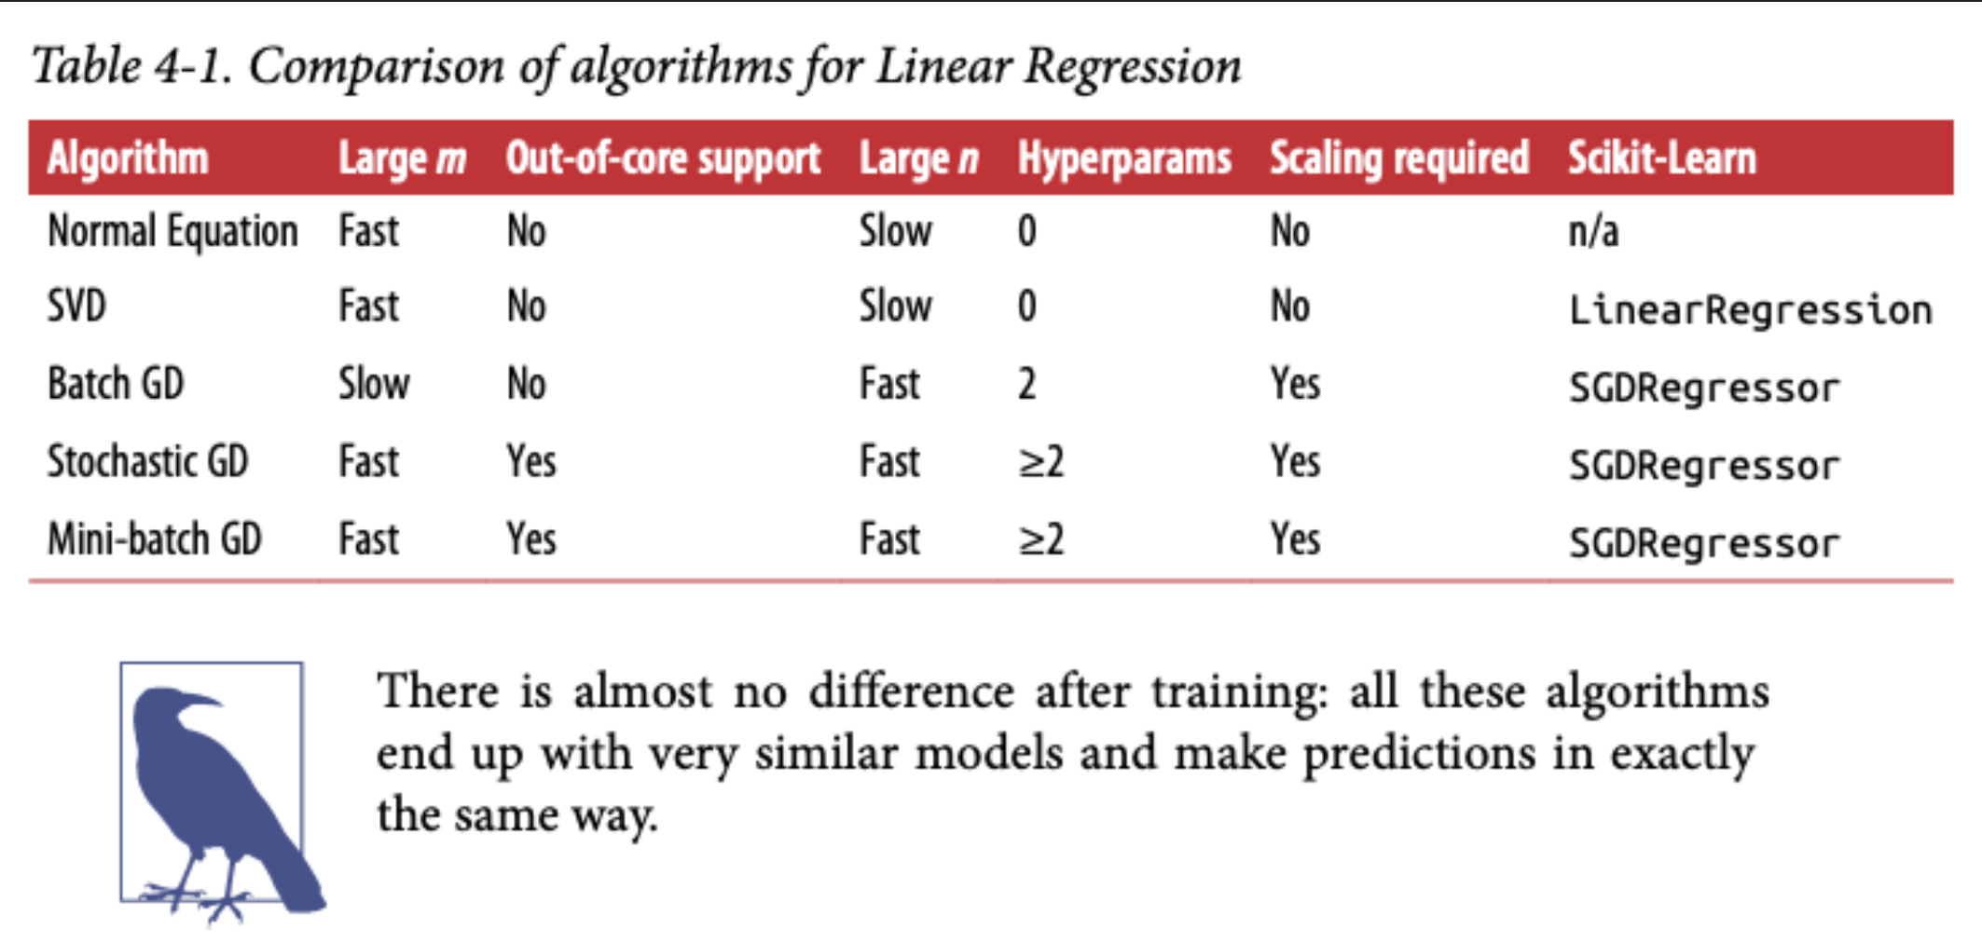
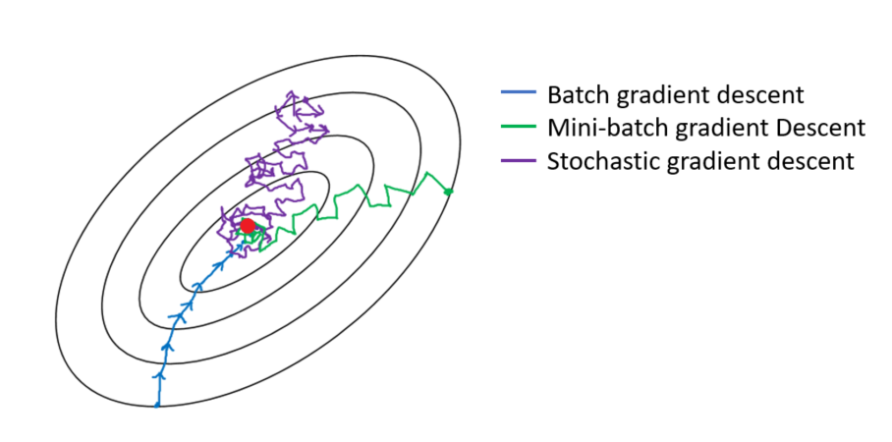
Mini-Batch Gradient Descent
Mini-batch gradient descent uses a smaller subset of data on each round (HP set).
Performance tendencies are between batch and stochastic, depending on batch size.
In our examples now, performance won’t really be different. In large/complex examples (like NN), small differences here can add up to massive differences.
We’ll spend more time with batch sizes when we get to neural networks.

Slide 34
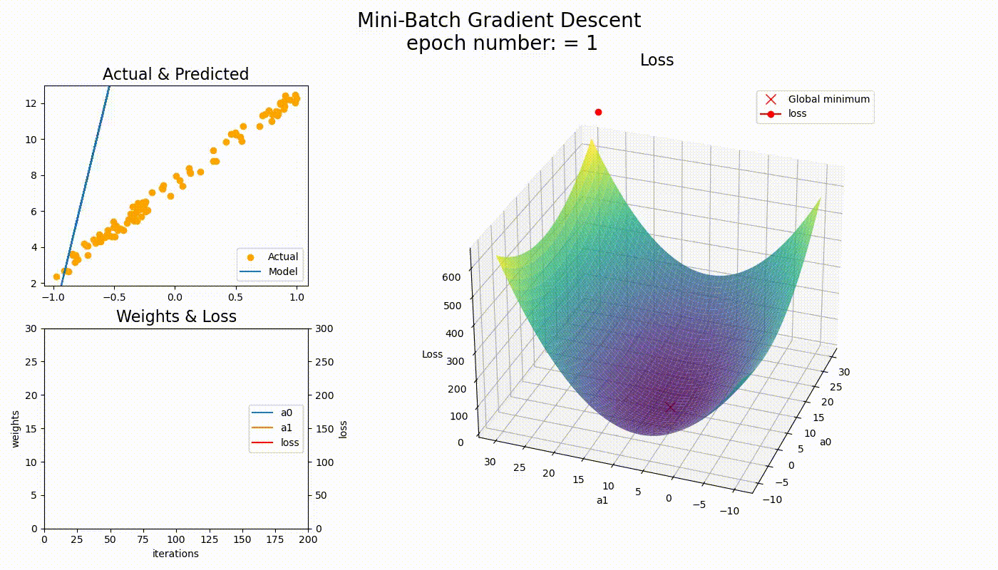

Slide 35
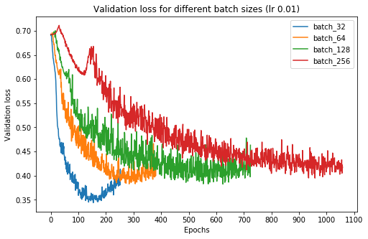
But Wait… There’s More…
For now, we can manipulate the batch size for speed/convergence.
Later, with neural networks and larger data, other factors emerge:
Processing a batch has some set costs, may want to maximize GPU usage.
Batch size has a hard limit of GPU RAM.

Slide 36
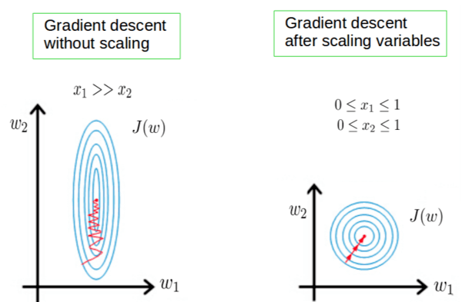
Scaling the descent
When using gradient descent, the values of the features are critical.
Recall, a linear model is made up of a bunch of param * feature terms.
The value of one feature being orders of magnitude different than another can skew results.
Using unscaled values makes it hard for the algorithm to converge.
This is generally true for most cases – we are almost always scaling variables.

Slide 37
Conclusion and Use
Gradient descent is an excellent (generic) method for finding an optimal solution.
For linear regression, we can calculate solutions, but this is often not true.
As long as we can define a cost function, we can optimize to it.
Applications:
Regularization (next time) – add a penalty to a cost function to combat overfitting. Use SGD to optimize that new cost function.
Neural networks – GD is commonly used in neural networks to find solutions.
Using NN in particular is big on incremental improvement while minimizing costs.
Complex models and large data mean many batches – efficiency matters a lot.

